Slide 1


Chunked, Compressed, & Cloud-native N-dimensional arrays
Lightning Talk @ NumFOCUS Summit 2023

Slide 2

Sanket Verma
@MSanKeys963
Community and OSS @ Zarr

Slide 3
Zarr Community

Slide 4
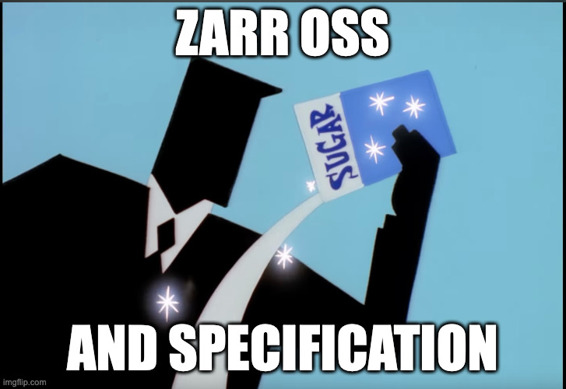

Slide 5
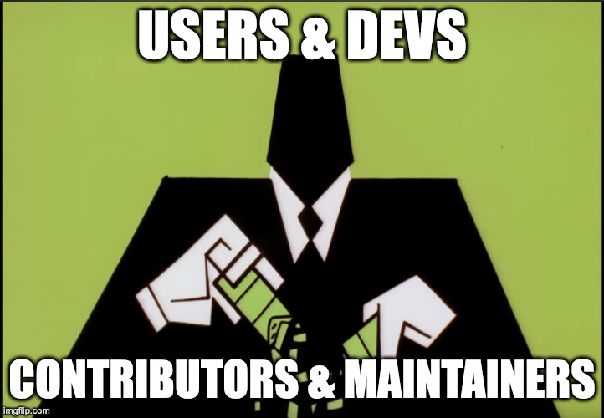

Slide 6
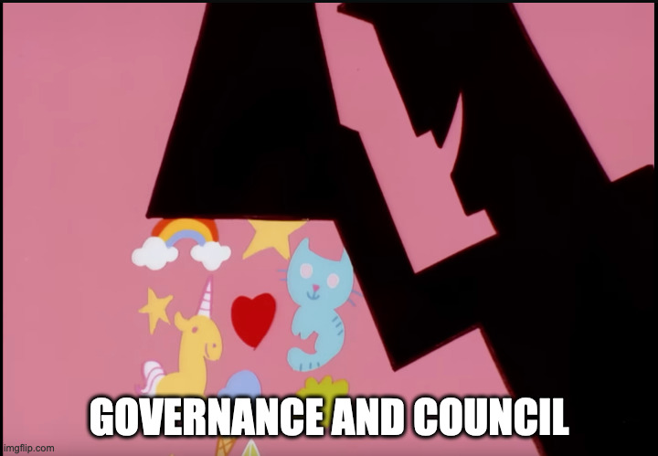

Slide 7


Slide 8
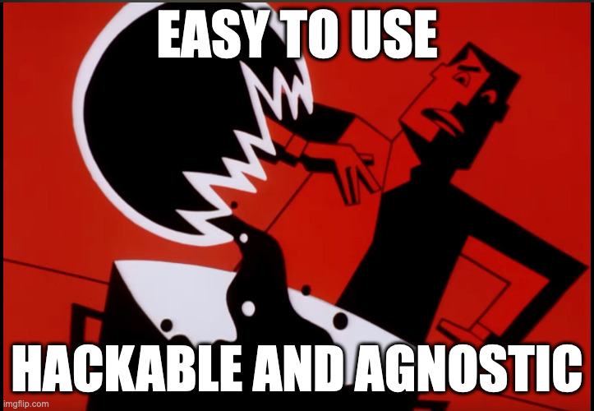

Slide 9
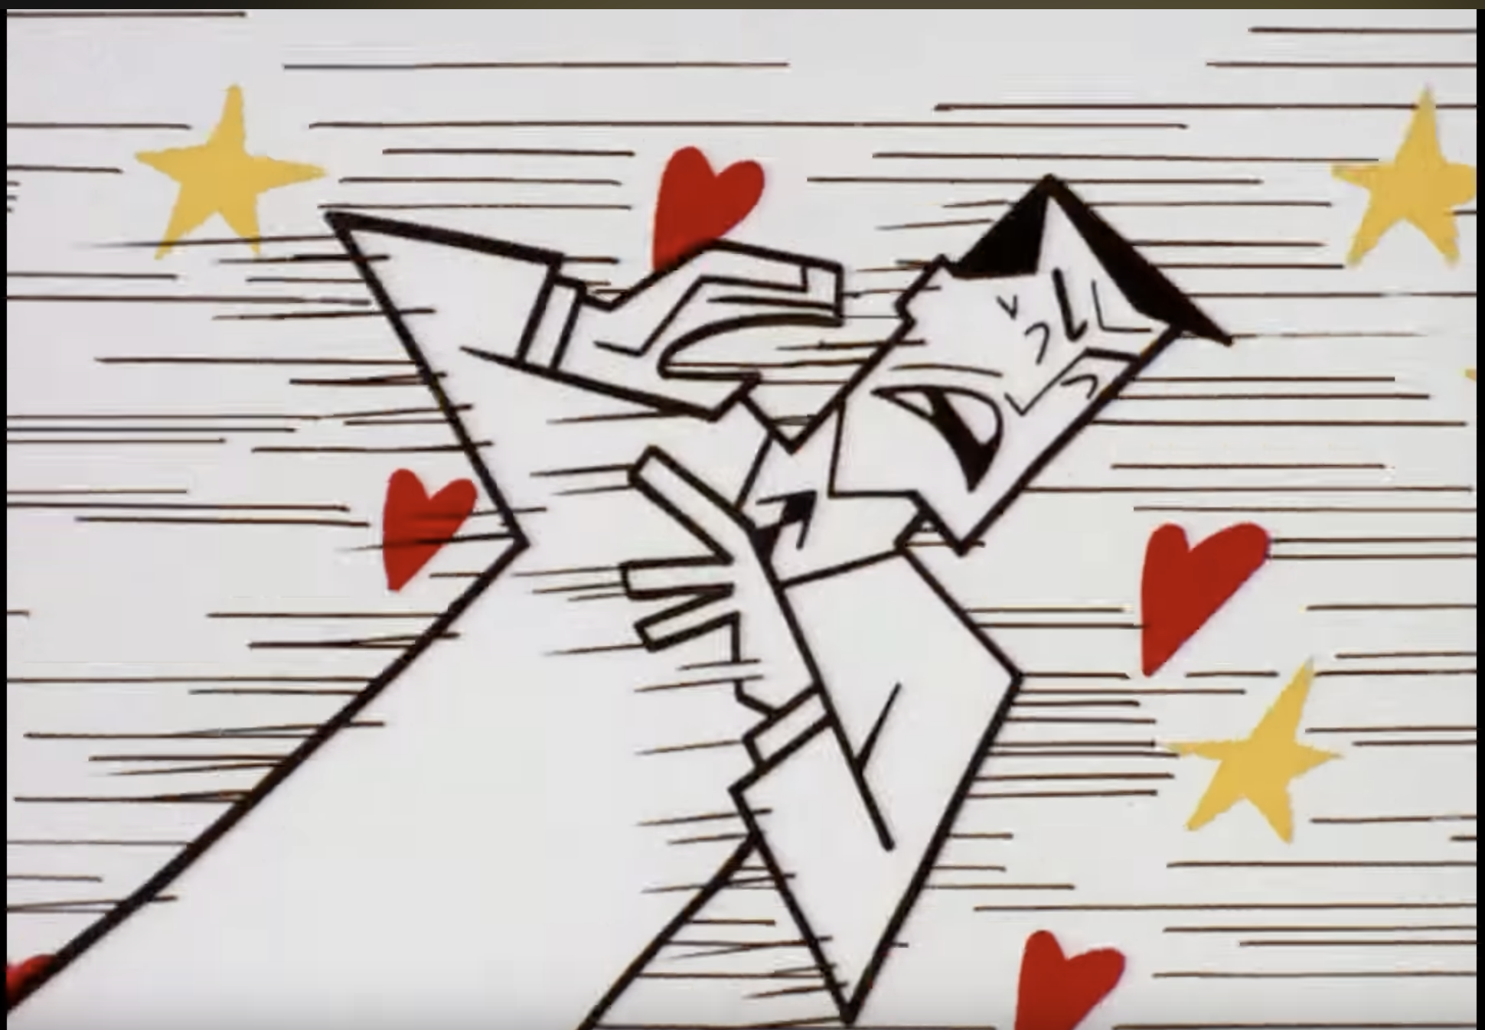

Slide 10


Slide 11


Slide 12
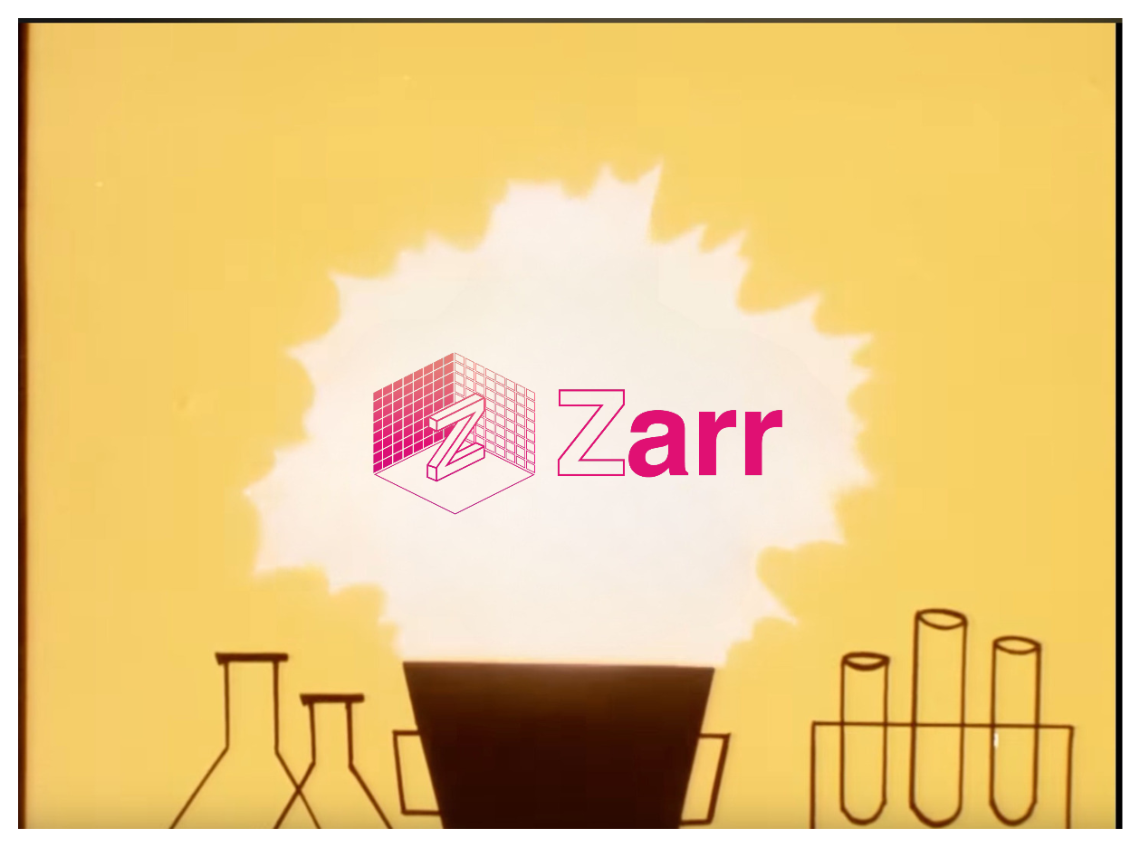

Slide 13
We have a large and diverse active community!
But…👀

Slide 14
We needed a structured way to solicit and *process* the feedback!

Slide 15
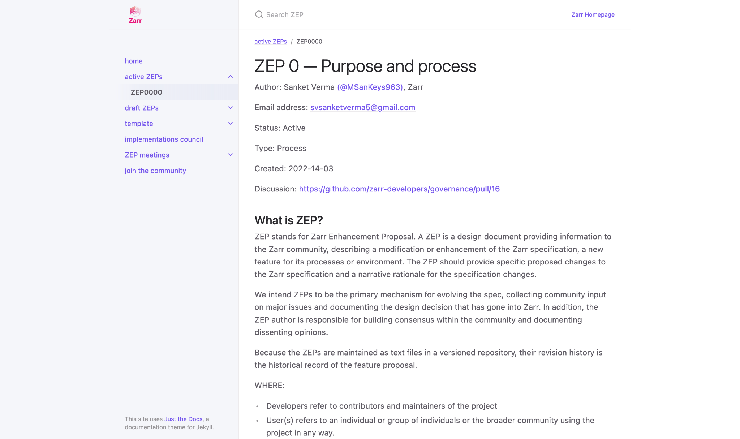
zarr.dev/zeps

Slide 16
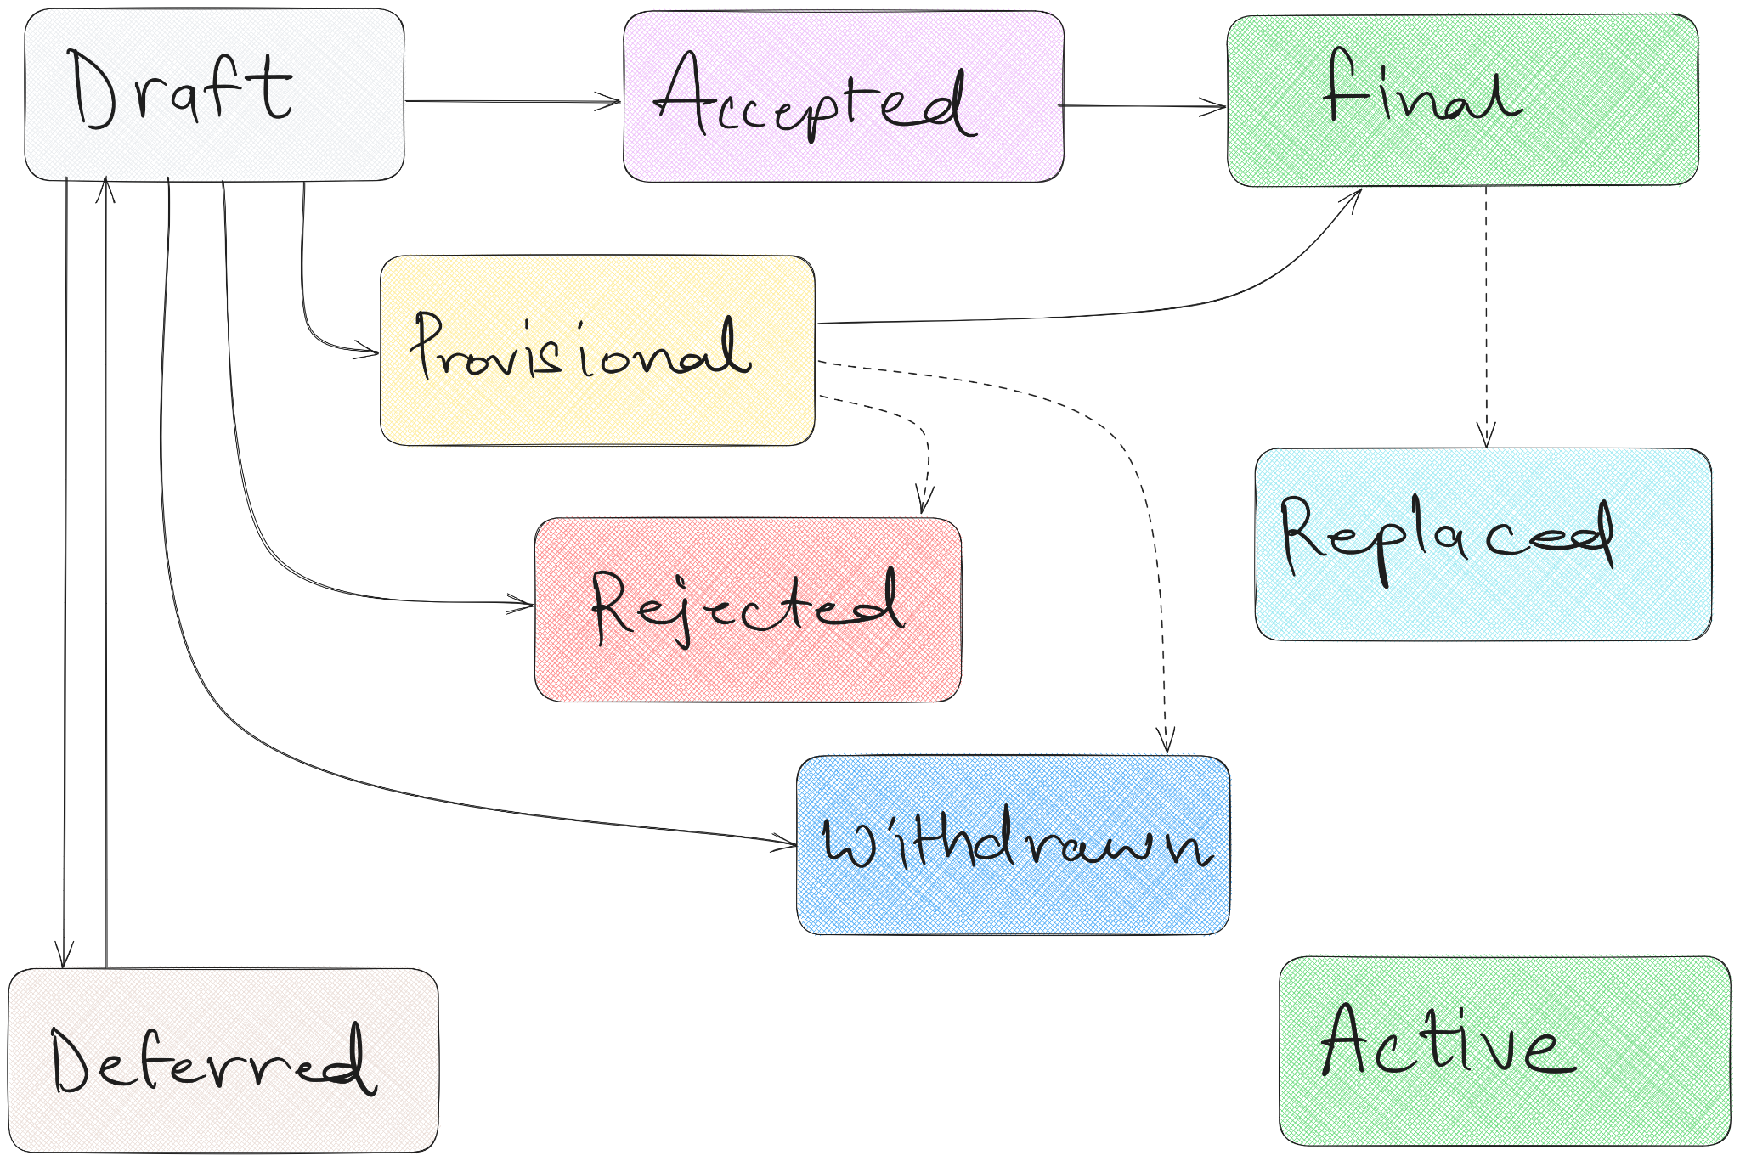
ZEP Flowchart ⤴↖↔

Slide 17
How we did it?🚶🏻‍♂️

Slide 18

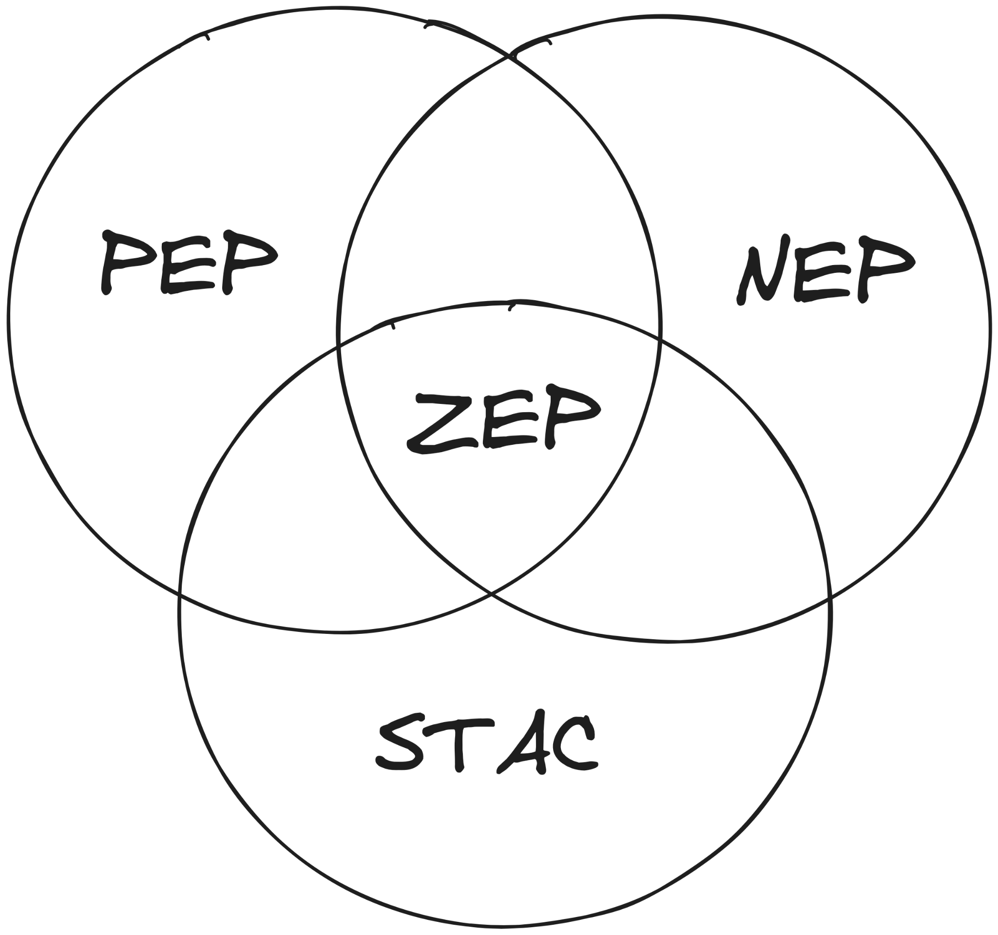

Lots of Reading
Previous Experience
Understanding the needs of the community

Slide 19
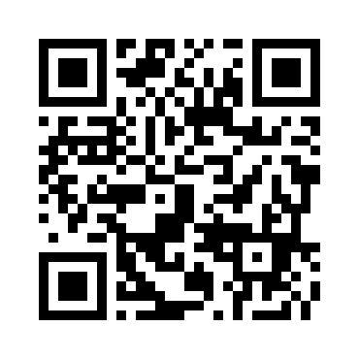
Braindump 🧠
ZEP Inception Blog post

Slide 20
How do we adopt a ZEP?

Slide 21








→

Slide 22
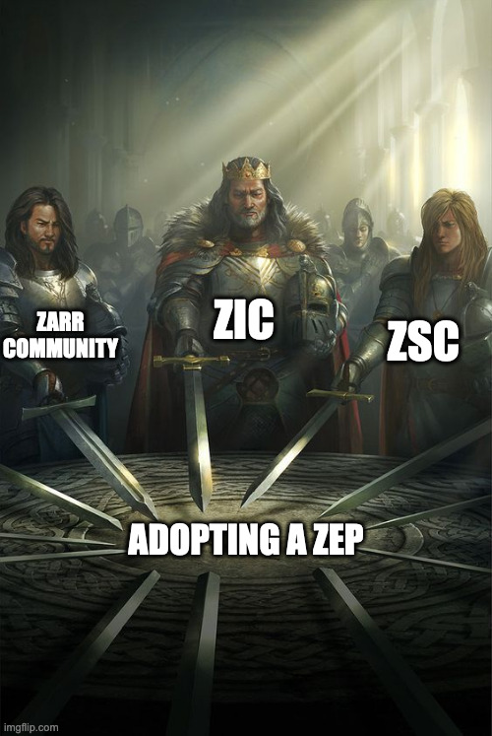

Slide 23
Submitted ZEPs
ZEP0001 - V3 Specification (Accepted)
ZEP0002 - Sharding Codec (In-voting phase)
ZEP0003 - Variable Chunking
ZEP0004 - Metadata Conventions
ZEP0005 - Chunk-level accumulation

Slide 24

🚧
Work in progress! 👷‍♂️
Notes:
ZEP0 is a living document
We’re always looking to improve it

Slide 25

Thank you! 🙏🏻
@zarr_dev

